Slide 1


Cloud for AI
Course 8: Deployment Technologies
Filotas Theodosiou

Slide 2
What are we going talk about today?

Slide 3
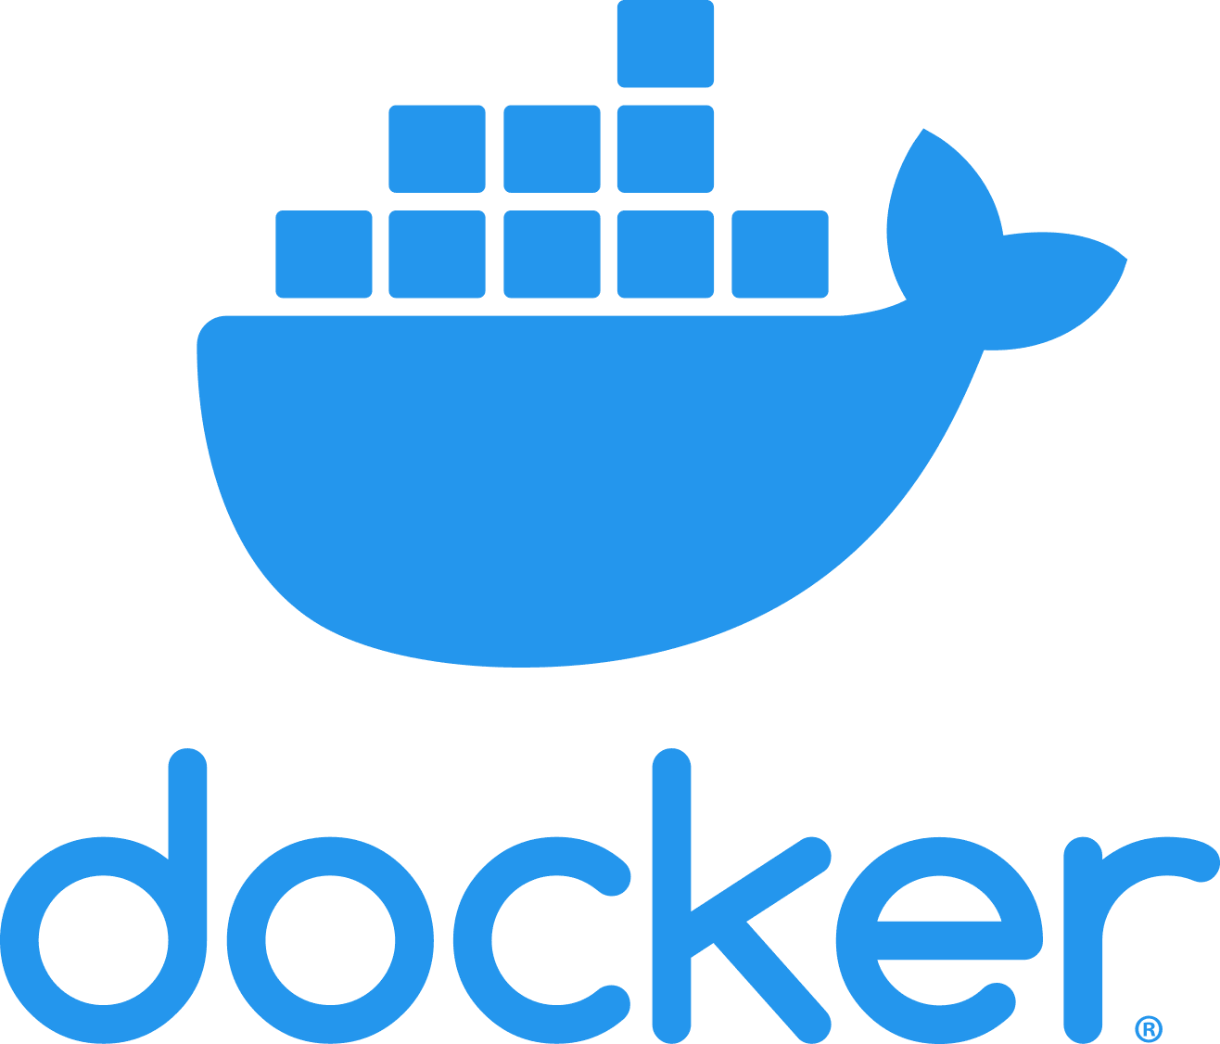



What are we going to talk about today
Notes:
We are going to talk about two of the most important tools in the toolset of a ML engineer!
Docker and FastAPI
These two are requested in almost every interview
I will not go super technical. I want for you to understand how do they work
In the second hour I will give you examples of how to use them

Slide 4
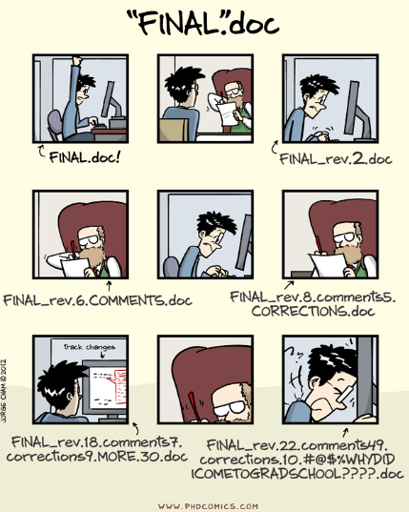

Slide 5
Git and GitHub
Version Control
Git, Git repository
Git vs Github
Setup git environment
Create a git repository
Git tools

Slide 6
Why version control?
Four important reasons
Collaboration -> develop simultaneously on different branches and collaborate
Versioning -> Keep history of previous versions
Rolling Back
Understanding
Imaginary (or not) scenario: Multiple students are doing a project together
How do they communicate their changes?
Notes:
One drive or google drive for files. But what about code?

Slide 7
What is Git?
Git (Global Information Tracker) is distributed version-control system.
You keep files in a repository on your local machine
You synchronize your repository with a repository on a server
Synchronizes changes when changing laptops.
If you partners uploads some changes you can pick them up by synchronizing

Slide 8
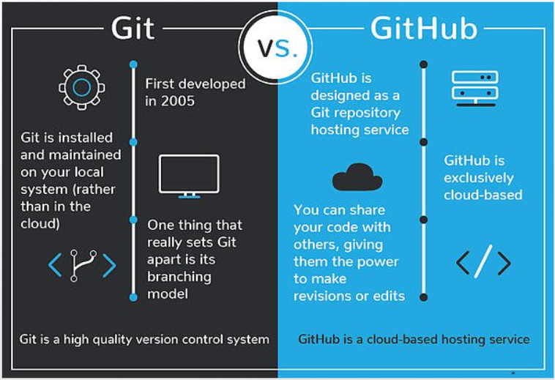
Git vs Github
Github is a site for online storage of Git repositories.
You do not need to use Github in order to use Git

Slide 9
A Simple Model on Git
my-project
docs
manual.docx
user_docs.docx
src
main.rkt
module1.rkt
module2.rkt
module3.rkt
Files on my local repository named: “my-project”

Slide 10
A Git Repository
You initialize a git repository with .git pointing at a mini-filesystem.
It keeps all your data, plus the instructions git needs to do its job.
All this sits on your local machine.
Github (git client) manages .git for you.
.git
my-project
docs
manual.docx
user_docs.docx
src
main.rkt
module1.rkt
module2.rkt
module3.rkt

Slide 11
A Git Repository
You initialize a git repository with .git pointing at a mini-filesystem.
It keeps all your data, plus the instructions git needs to do its job.
All this sits on your local machine.
Github (git client) manages .git for you.
.git
my-project
docs
manual.docx
user_docs.docx
src
main.rkt
module1.rkt
module2.rkt
module3.rkt
You can edit your local files directly -> Edit, add, delete using any tools you want

Slide 12
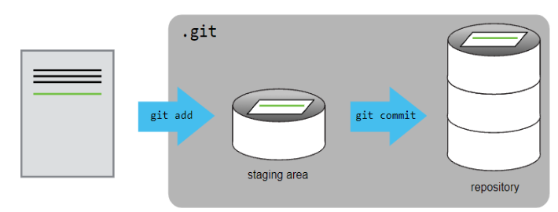
Local Actions: A Commit
You can edit your local files directly -> Edit, add, delete using any tools you want
Add a new row

Slide 13
Local Actions: A Commit
You can edit your local files directly -> Edit, add, delete using any tools you want
.git
my-project
docs
manual.docx
user_docs.docx
commit
src
main.rkt
module1.rkt
module2.rkt
module3.rkt

Slide 14
Local Actions: A Commit
You can edit your local files directly -> Edit, add, delete using any tools you want
.git
When you do a “commit”, you record all your local changes into the mini-filesystem
my-project
docs
manual.docx
user_docs.docx
commit
src
main.rkt
module1.rkt
module2.rkt
module3.rkt

Slide 15
Synchronizing with the Server: The Push
a server, somewhere on the internet, eg. github.com
your local machine
.git
my-project
docs
manual.docx
user_docs.docx
src
main.rkt
commit
module1.rkt
module2.rkt
module3.rkt

Slide 16
Synchronizing with the Server: The Push
a server, somewhere on the internet, eg. github.com
your local machine
.git
my-project
docs
manual.docx
user_docs.docx
src
main.rkt
commit
module1.rkt
At the end of each work session, you need to save your changes on the server.
module2.rkt
module3.rkt

Slide 17
Synchronizing with the Server: The Push
a server, somewhere on the internet, eg. github.com
your local machine
.git
push
my-project
docs
manual.docx
user_docs.docx
src
main.rkt
commit
module1.rkt
At the end of each work session, you need to save your changes on the server.
This is called a “push”.
module2.rkt
module3.rkt

Slide 18
Synchronizing with the Server: The Push
a server, somewhere on the internet, eg. github.com
your local machine
.git
push
my-project
docs
manual.docx
user_docs.docx
src
main.rkt
commit
module1.rkt
At the end of each work session, you need to save your changes on the server.
This is called a “push”.
Now all your data is backed up.
You can retrieve it, on your machine or some other machine.
Other people with access can retrieve it
module2.rkt
module3.rkt

Slide 19
Synchronizing with the Server: The Pull
a server, somewhere on the internet, eg. github.com
your local machine
.git
my-project
docs
manual.docx
user_docs.docx
src
main.rkt
module1.rkt
module2.rkt
module3.rkt
To retrieve your data from the server:

Slide 20
Synchronizing with the Server: The Pull
a server, somewhere on the internet, eg. github.com
your local machine
.git
pull
my-project
docs
manual.docx
user_docs.docx
src
main.rkt
pull
module1.rkt
module2.rkt
module3.rkt
To retrieve your data from the server, you do a “pull”.
A “pull” takes the data from the server and puts it both in your local mini-fs and in your ordinary files.

Slide 21
Synchronizing with the Server: The Pull
a server, somewhere on the internet, eg. github.com
your local machine
.git
pull
my-project
docs
manual.docx
user_docs.docx
src
main.rkt
pull
module1.rkt
module2.rkt
module3.rkt
To retrieve your data from the server, you do a “pull”.
A “pull” takes the data from the server and puts it both in your local mini-fs and in your ordinary files.
If your local file has changed, git will merge the changes if possible. If it can’t figure out how to the merge, you will get an a conflict error

Slide 22
The Full Picture
a server, somewhere on the internet, eg. github.ccs.neu.edu
your local machine
push
.git
pull
my-project
docs
manual.docx
user_docs.docx
src
commit
main.rkt
pull
module1.rkt
module2.rkt
module3.rkt

Slide 23
The typical workflow
sync
edit
Best practice:
Commit your work whenever you’ve gotten one part of your problem working.
Or before trying something that might fail.
If your new stuff is screwed up:
You can always “revert” to your last good commit.
commit
edit
commit
edit
commit
sync

Slide 24
Your Workflow with a partner
You
Your Partner
You
sync
sync
sync
edit
edit
edit
commit
commit
commit
edit
server
edit
server
edit
commit
commit
commit
edit
edit
edit
commit
commit
commit
sync
sync
sync
Your partner gets your work from the server
You get your partner’s work from the server

Slide 25
Download and Install Git
Download git from: http://git-scm.com/downloads
First time set-up
git config -- global user.name “GithubUserName”
git config -- global user.email “GitHubEmail”

Slide 26
Basic Commands
Move to your projects folder and start a directory
cd ~/Cloud-for-AI
mkdir first_demo
cd first_demo
Initialize a git project on the existing directory => git init .
Stage changes => git add <filename>
Create a commit with a message to keep track of commit history => git commit -m “Your message”
Push changes: git push
Pull changes: git pull

Slide 27
Some extra stuff
Git for windows: https://desktop.github.com/
The .gitignore file => Specify files you do not want Git to track under version control (eg. big files, files with passwords etc)
Branching and merging => Different branches for different development circles (watchout for conflicts)
Remotes: A target computer that has Git repos that you can access
Create a new repo on Github
Copy the Repo’s URL (eg. git@github:fake_example.git)
Create a new local repository (follow steps in previous slide)
Link it to remote: git remote add origin git@github:fake_example.git
Push it: git push -u origin master

Slide 29
Reproducibility!

Slide 30
The importance of reproducibility
A ML life cycle is a long process repeated multiple times.
Small changes can make significant difference.
We want to ensure reproducibility of code, data, models
Why?
Collaboration
Developer A on laptop A needs to have the same outcome with Developer B
Fallback & model recreation on system failures
If the model fails we need to recreate an exact previous version that we know works properly
Scalability
Through a consistent deployment model we can automate scaling on ML applications
Notes:
Lets first understand why are these super important.
As we said multiple times an ML circle is repeated several times!
Very small changes can make significant difference!
As we have mentioned we need to ensure rporducibilitY
Why?
(read why one by one)

Slide 31
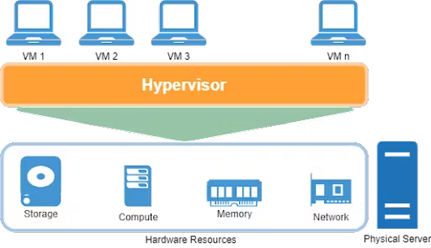
Solving reproducibility
Several solution exist to ensure system-level reproducibility in ML projects.
Virtual Machines:
Multiple isolated OS instances running on the same physical hardware
(Multiple computers inside your main computer with their own programs and OS)
Limitations:
Resource Intensive: VMs use a lot of memory and processing power
Disk Space: Each VM takes a lot of space on your hard drive
Slower Performance: Running multiple VM is computationally exhaustive
Notes:
So the question becomes. How do we solve reproducibility?
The first and most widely applied solution out there is Virtual Machines.
You can picture them as isolated operating system inside the same computer, the same hardware
Many computers, within your own computer with their own programms and operation systems.
So in order to run the same application you re-initialized one of these virtual machines
The limitations?
Many limitations (read them)

Slide 32
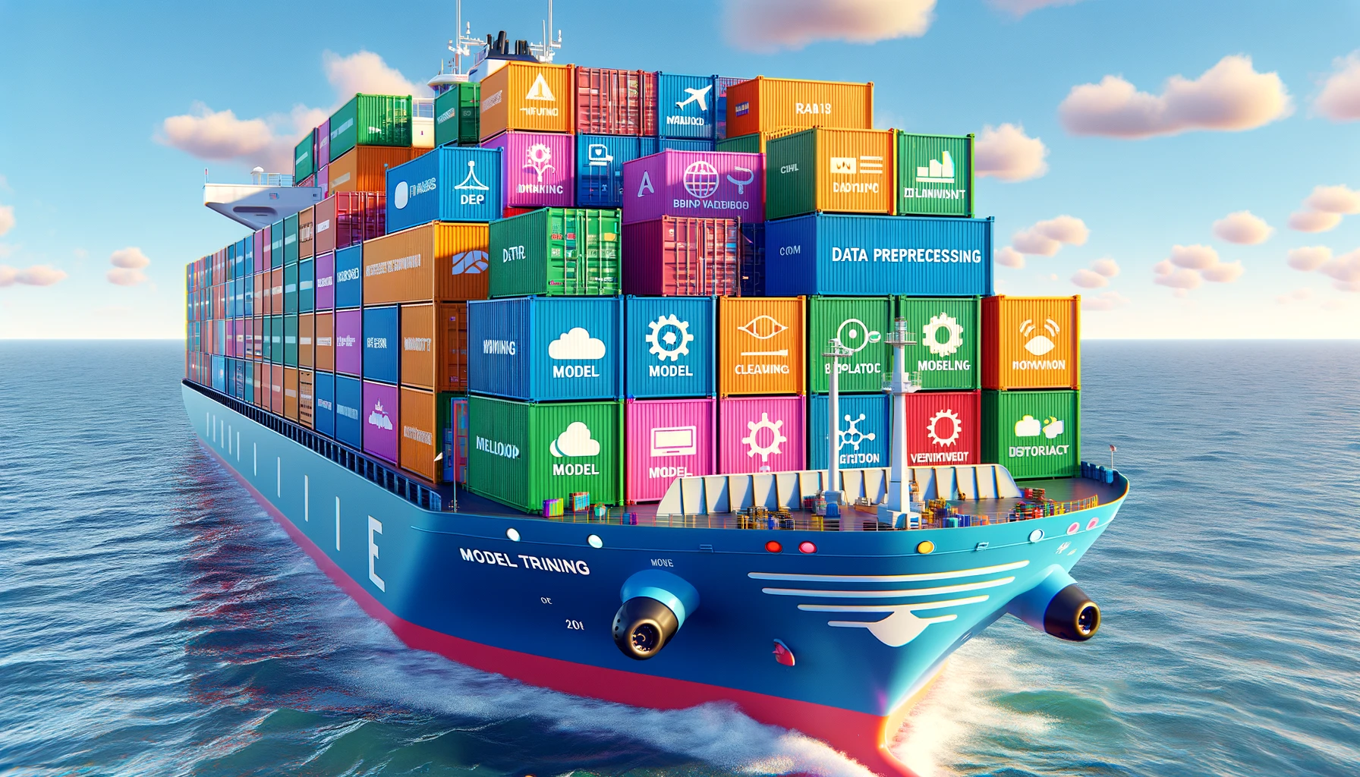
Enter Containerization
Containerization:
A way to package applications with everything they need (dependencies, configurations etc)
Notes:
So these limitations lead us to containerization
you can picture it as a way to package applications with everything they need (dependencies, configurations etc) and then ship them to another computer or the cloud
you can see in the picture within one enterprise we have many containers
One container for the model, the other for another model, another for data
Each application has its own container and is being shipped to another user

Slide 33
Why containers?
They do what VMs dont!
Portable
Easily shared and moved around between teams with different environments
Isolated from host systems
They can run as standalone entities on a device without the need for resource boundaries
Lightweight
You can have multiple containers on a single host
Resilient & Scalable
Inexpensive and simple to implement for resiliency
Notes:
So why containers!
Lets discuss their advantages over Virtual Machines
First of all they are portable. You dont need to have the same computer. You can move them around any teams or environments. Thats a big plus
Next they dont need to work with their host computer. You can use them anywhere on any computer. That relaxes the dependencies for high resource usage!
They are much lighter than VM. You can have many open at the same time. For example a developer friend of mine works with 12 containers open!
Lastly they are resilient which is very important. you are not losing them and you can easily scale them!
These are very key advantages over VMs and its why containers are the go-to for reproducibility!

Slide 34
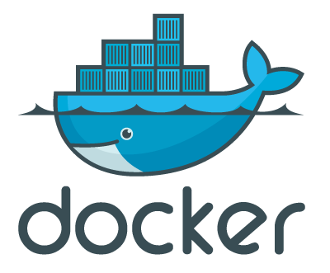
Hello Docker
What is Docker?
Docker is an open platform for developing, shipping and running applications inside containers.
Docker in a sentence:
Rapid shipping, testing and deployment of code and applications, significantly reducing delay between writing code and running it in production
Notes:
Allright, enter Docker.
So Docker is what runs containers. Is an open platform for developing, shipping and running the applications.
Everything is taking place within Docker.
If I could define it in a sentence: (read it)

Slide 35
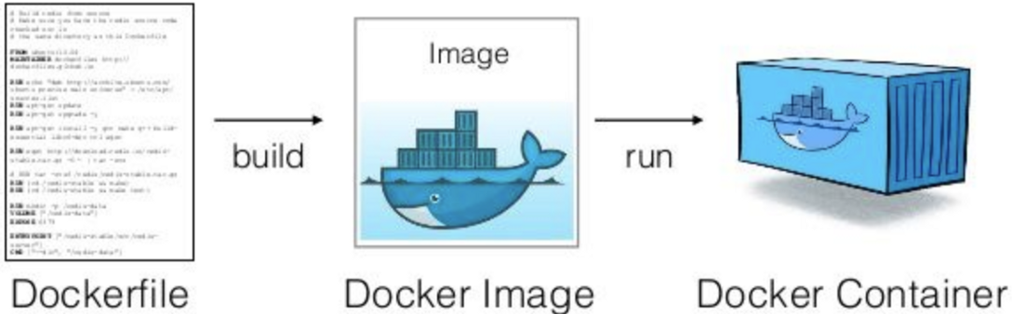
A quick overview!
What is an image?
A recipe that contains the application and the dependencies.
Its the blueprint/image of the file. Container is a running instance created from an image
What is a container?
Think of them as boxes where the application lives with all its dependencies (OS, libraries, versions etc)
Notes:
These are the main components of Docker.
Lets take them step by step
First we have a Dockerfile. Its how we communicate with Docker. How we explain to it what we need for our application. We will see how to write them later. You can imagine it as the script to run Docker
Next we have Docker images. An image is just a screenshot of the Dockerfile. Its the blueprin of what we want to build. So docker takes a dockerfile and we make an image out of it. Its what is kept saved for our application
Finaly we have the container. Every time we run the image we get a container that has everything written in the dockerfile and is printed in the Docker Image
So the flow is, write the Dockerfile, build an image that is a screenshot of the dockerfile and then run a specialized Container.

Slide 36
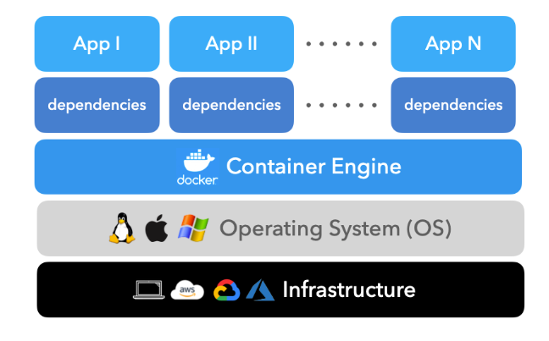
Docker Architecture
Say we have multiple apps open!
Containers contain our applications and dependencies
Container engine (Docker) runs containers
Docker runs on top of our operating system
Our OS is hosted on an Infrastructure
Notes:
Lets quickly now go through the architecture of docker.
Say we have some infrastructure, it can be a computer, a Cloud instance, anything.
On top of our Infrasturcture we have an Operation System, say Linux, Windows anything.
Then we have a Container engine. In our case Docker!
Within Docker we can run as many applications as we want.
We can have an application on a container for the frontend, another for the backend etc!
This is a general overview of Docker’s architecture!

Slide 37
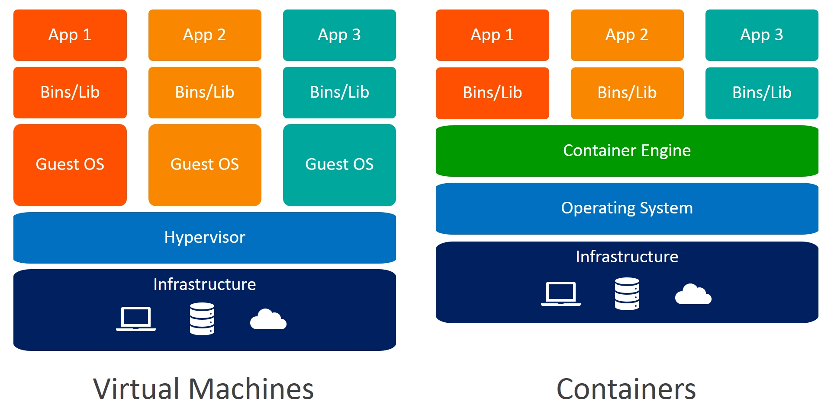
Docker vs Virtual Machines
Docker containers
Shares the host OS making them lightweight
Uses less memory and disk space
Starts in seconds
Virtual Machines
Each VM has its own OS, making them heavier
Longer to start
More memory and disk because of OS overhead.
Notes:
Now lets compare it with VMs.
The key difference is that containers share the same host OS. that makes them super lightweight
On the other hand VMs require their OS to run which makes them heavier and as aresult take longer to start, have more memory etc.
So With Docker because you can share the OS, you save much more memory and as a results you can run many instances much much faster!
Everything clear so far?
Any questions now?

Slide 38
Installation Docker
Ensure Python (version 3.10 or above) is installed
Ensure IDE (Visual Studio Code is the go-to)
Download and install Docker Desktop
If you get the error WSL2 installation is incomplete, then download and install the latest package wsl_update_x64
Make an account on Docker Hub
Log in with your account on Docker Desktop
Note: Ensure github account
If you have any problems installing Docker please email me!!
Notes:
just follow the lines here

Slide 39

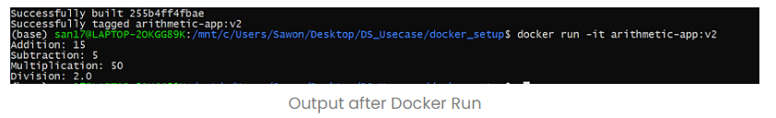
Using Docker
Assume you have “dockerized” a simple application doing math operations:
Then I can take your container and run it on my laptop!
Nothing more :)
Notes:
Ok. Lets see how we can run docker now.
Say you have dockerized a simple application that does some mathematical application between two numbers, say 5 and 10.
When you have compiled the image (from the Dockerfile) you can simply run a container on your laptop.
You simply click docker run and the name of the application!
And thats it!
Pretty straightforward pretty easy!

Slide 40
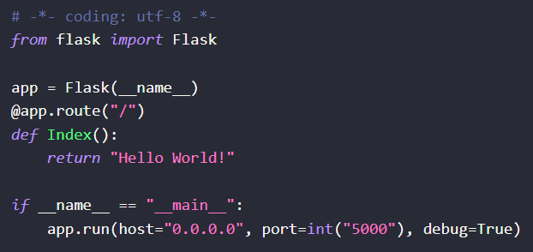
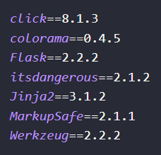

How Docker works?
Step 1: Build your .py application!
Step 2: Create requirements.txt
Notes:
Ok. Now lets build an image together.
Remember, we have a Dockerfile, we build an image and from that image people can make containers of our application.
Lets see how we make the Dockerfile
Say we have build an application that just prints hello_world.
We have written it and compiled a simple .py file
The next thing is to create the requirements we need to run the application
you go on terminal and write the pip freeze > requirements.txt that takes all the libraries we have installed on our virtual environment and send it to the txt file
This is what the txt file will look like
Each library with each specific version
Carefull, versions are very important for python and can cause many conflicts so we have to define them very carefuly!

Slide 41
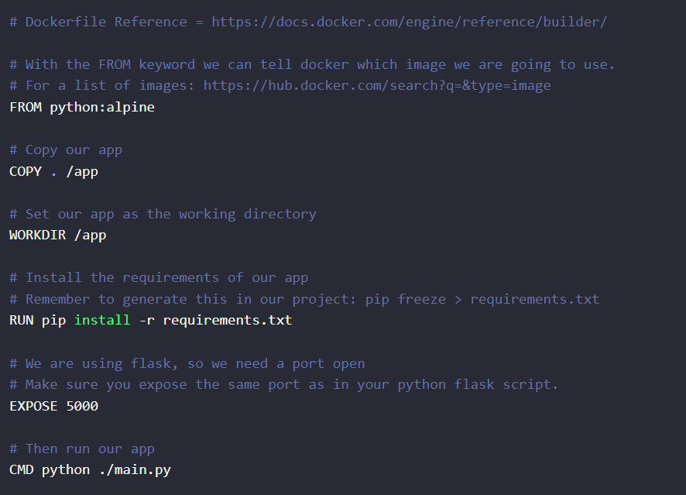
How Docker works?
In the main project folder create a file:
DockerFile (no extensions)
Step 3: Build the DockerFile
Note:
Dockerfile is usually the end artifact of a ML engineer before giving it to the next team!
Notes:
After having build the requirements we go and build our dockerfile.
Its very important to remember that a Dockerfile is usually the end artifact of a ML engineer.
We take that and we pass it to the next team that is responsible for integrating it with the rest of the application.
Remember. Dockerfile has no extension!!
So in the name folder, next to requirements.txt we build a Dockerfile without any extensions
Just the Dockerfile
Its that simple!

Slide 42
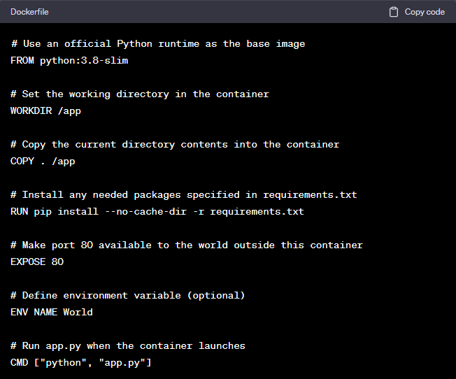
Dockerfile: The thing that matters!!
Definition:
A script containing commands to assemble a Docker Image
Structure:
Lists the base image, software to install, files to copy, ports to expose and the commands to run the application
Purpose
Ensures consistency and reproducible builds
Notes:
Oke. Lets check how we build the Dockerfile.
As we said its a simple script that contains the commands to build the Dockerimage
Its like commands!
So what is the structure like:
In general on a dockerfile we want to include teh following:
The base image
The software we are going to install (libraries and so on)
The files we want to copy
The port we are going to use and how to run our application.
As we said we do it to ensure reproducibility.
Lets review it step by step.
First we define the official python runtime as our base image. That means we are going to use python to run our container
We set the WORKDIR to the working directory we are going to use in the container. In our case this is the /app folder. Instead of /app just add the name of your folder
Next we want to copy all the context of the workdir to the container. So every file, every folder in the main /app folder is copied to the container
Next we install all the requirements we have frozen from the virtual environment and expose a port to run the application.
Lets skip the environment variable here
Finaly we want to define what we run! We type CMD to initiate the command line, we run python and within python we run app.py
thats it! Very simple to build a Dockerfile

Slide 43

How Docker works?
Step 5: Build a container based on the image
Step 4: Build the image!
docker run -- name <name_of_container> -p <contaner_port>: <host_port> <name_of_image>
Or for more simple applications:
Notes:
Then we build the image using the build -t command on the command line and the image is ready!!
When we want to run our application (our container) from the image we hit the fullowing commands.
(Just show what we read)

Slide 44
Ok wait, Where are the images?
Docker Hub is a service provided by Docker, for finding and sharing container images with your team.
(picture it as what GitHub is to Git)
Its free, public and contains container images from every project in the world!
Some important features:
Repositories: Push and pull container images.
Teams & Organizations: Manage access to private repositories of container images.
Docker Official Images: Pull and use high-quality container images provided by Docker.
Docker Verified Publisher Images: Pull and use high- quality container images provided by external vendors.
Builds: Automatically build container images from GitHub and push them to Docker Hub.
Notes:
ok! Now we have build an image what do we do? How can we access them?
This is where DockerHub comes.
You can picture it as Github for git.
Its where we store all the images, we share and we take container from our team.
Lets check some features
You can have repositories where you push and pull your image (similarly with github)
You can give access to the repositories to anyone you want. It can private, public anything
So the main funcionaility is that you build an image you push it to DockerHub. A team members then can pull that image and run a container out of it!
If we have time later we will see you can work with DockerHub
Is everything clear here??

Slide 45
Summary of Docker
Benefits of using Docker for ML Models.
Scalability & Independence of Services
Docker enables scalability and simple addition/removal of services even in different languages
Reproducibility
Ensure the working environment for training, testing, deploying the model is the same across all servers
Resource Utilization:
Construct your model locally and transfer it for training into multiple instances on a cloud server
Version control
Track image versions, roll back if needed on all servers at the same moment.
Notes:
Ok lets summarize!
Just read it and son

Slide 46
What's next?
Serving
Notes:
Allright. This was Docker
Lets move to our next tool

Slide 47
What's next?
Notes:
FastAPI. A very important framework for you to work on. As with Docker I will give a simple demonstration of how it works and you can extend it as much as you want!

Slide 48
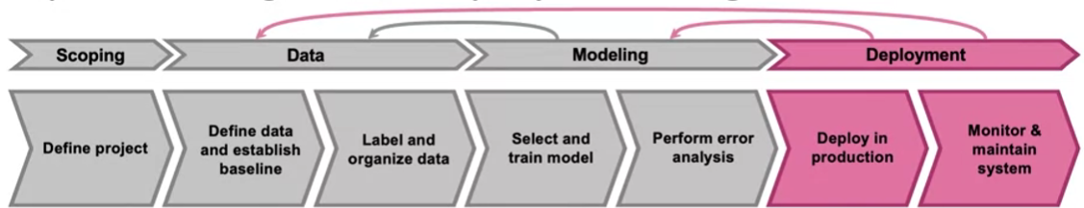
A quick reminder on deployment
Deployment: Deployment is the process of integrating a trained machine learning model into a production environment to make it available for end-users.
Serving: Set-up the hardware and software to serve the model predictions on cloud or edge devices
Scalability: Ensure the model can handle varying loads from few requests to thousands per second
Versioning: Keeping track of different version of the model allowing for rollbacks, A/B tests etc
Monitoring: Monitor the performance of the model in the real world and collect feedback
Deployment is an iterative process! Feedback is used to improve the performance of the model!!
Notes:
Lets first revise what is the deployment stage.
On deployment, we take our trained ML model and we put it into the production environment so its available for the end-user
The idea is that we want to “serve” the model. We want to have the model ready to make predictions
This can be either on the cloud or any edge device.
This is the main idea behind serving and deployment
Make the model ready for the end user

Slide 49
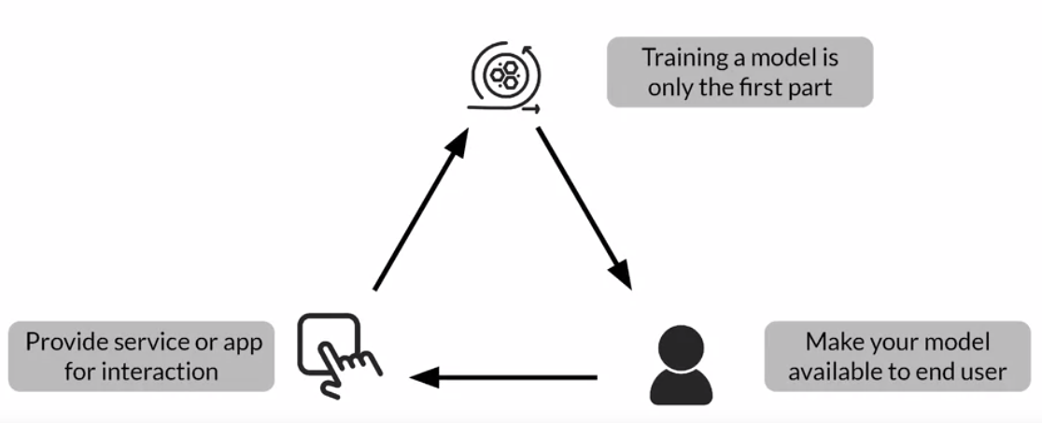
What Exactly is Model Serving?
Training a good ML model serves nothing on its own
You need to make it available for usage
You do that by providing access to it through serving!
Notes:
And then of course as we have said, we take the feedback and we might want to improve our model

Slide 50


A Case Study: Speech recognition
Mobile Phone (Edge Device)
Local Software
Speech API
Voice
Detection and
Classification
VAD
Module
Microphone
Prediction
Server
Transcript
Classification
Frontend Code
Notes:
I guess you remember this example!
We will talk about this later in more detail
A quick review.
(explain how everything works here)

Slide 51
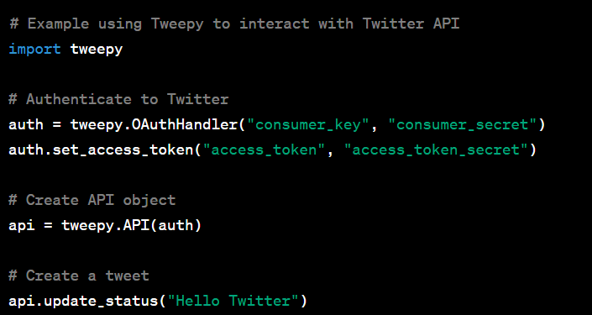
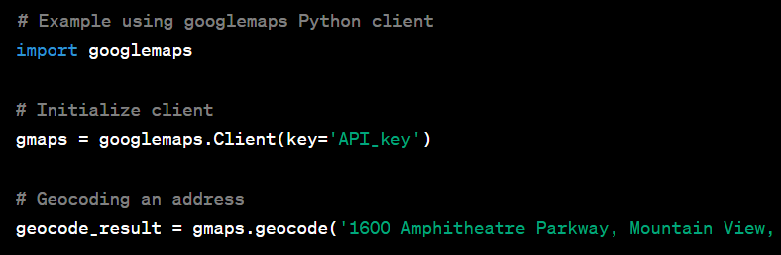
First things first. What is an API?
Definition:
Application Programming Interface (API) is a set of rules by which different software applications can communicate with each other!
Analogy:
Think of an API as a waiter in a restaurant. You (the Customer) make a request for a dish, the waiter(the API) takes the request to the kitchen (the System), and then he brings the dish to you.
Examples
With Twitter API you interact with Twitter data. Make request to make or get a tweet
With Google Maps API you retrieve data from Google Maps
Notes:
Allright now lets try to break things down.
We want to start by explaining what exactly is an API!
An API is a set of rules that is beeing transmitted so different applications can communicate with each other
Its like sending a request from your programm and getting a reply from the another software
Picture this analogy
An API is a waiter in a restaurant. You make a request, an order, you want to roder a plate and the waiter takes your request ot the kitchen (the other system)
The system then takes some actions, prepares your plate
Finaly the waiter(the API) takes the result of your request and returns it to you
Lets see some simple examples with API calls to tweeter and google maps
(read the examples)

Slide 52
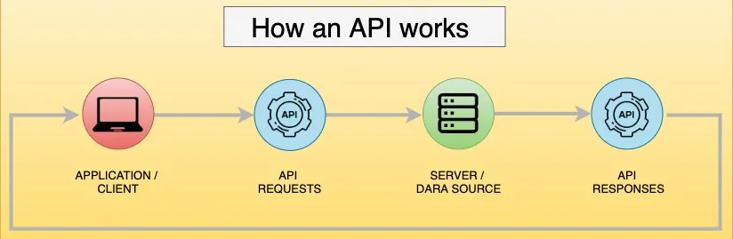
APIs in the ML world
APIs bridge model implementations to applications!
In simple terms it allows the integration of (pretrained) ML models (or other components) into application systems.
Scenario 1:
A retail company has developed a demand forecasting model. Through an API, this model can be integrated into the company's inventory management system to help automate re-stocking decisions.
Scenario 2:
A financial services firm has multiple ML models for fraud detection, risk assessment, etc. APIs enable these models to work in parallel or be accessed by various internal or external systems.
Notes:
Now lets see how APIs work in the ML world.
An API is the bridge betweein taking the pretraied model and throwing it to the world.
To make it simply it allows our pretrained model that works on our machine to be used by other users or other team member somewhere else .
They can make applications or simply integrate it in their applications
Lets review some examples (read the examples here)

Slide 53
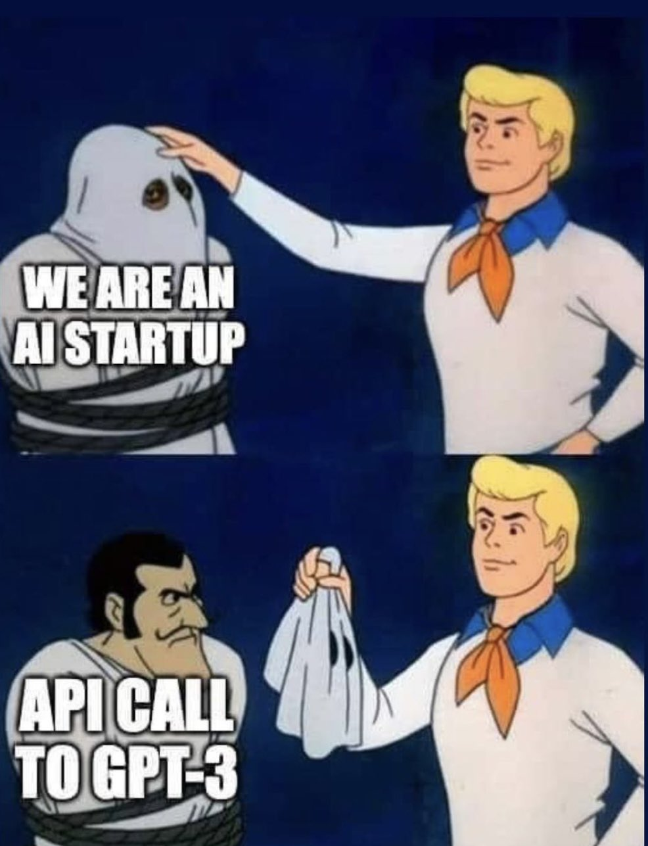
APIs run modern applications
Notes:
In 2023, APIs are everywhere. Its the key that has enabled the revolution of AI that we are witnessing.
There are thousands of startups that are being developed every month that simply leverage an API from a pre-trained model.
So whats the idea? A big company like OpenAI takes a big model that is hard to built and makes it available through an API
Users can interact with these models and integrate them into their applications.
Of course with a small fee per request!

Slide 54
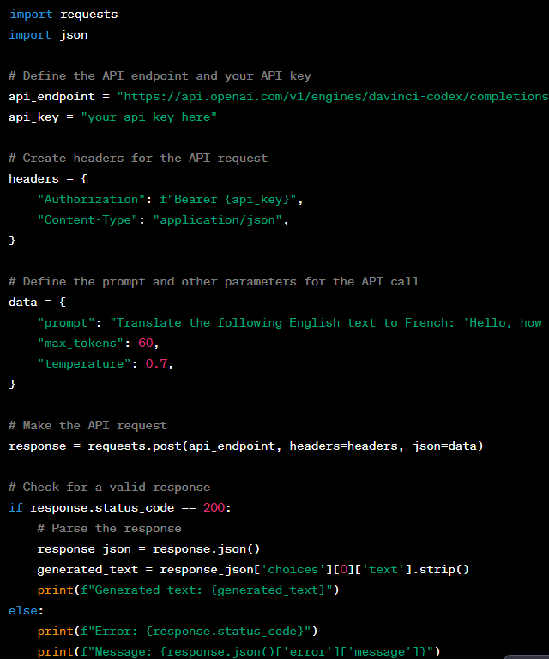
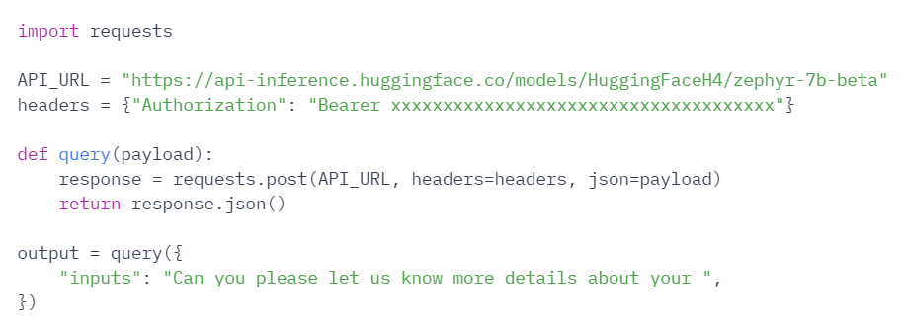
APIs run modern applications
Why?
Simple API calls to Large Pretrained Models make cool startups!
API call to gpt-3 from openAI
API call to Zephyr-7b from Hugging Face
Notes:
And if you remember we have used several examples when we developed streamlit applications.
API calls to LLMs is the key in our modern world.
You can see how simple it is.
I just make an API call to Zephyr-7b, a recent model that is hosted on Hugging Face
So HuggingFace is the reposotiory for all pretraine dmodels.
Or check this example, how easy it is to use gpt-3 from openAI to make request! Very straightforward!
So in some sense, users through APIs can integrated big models to their pipelines

Slide 55
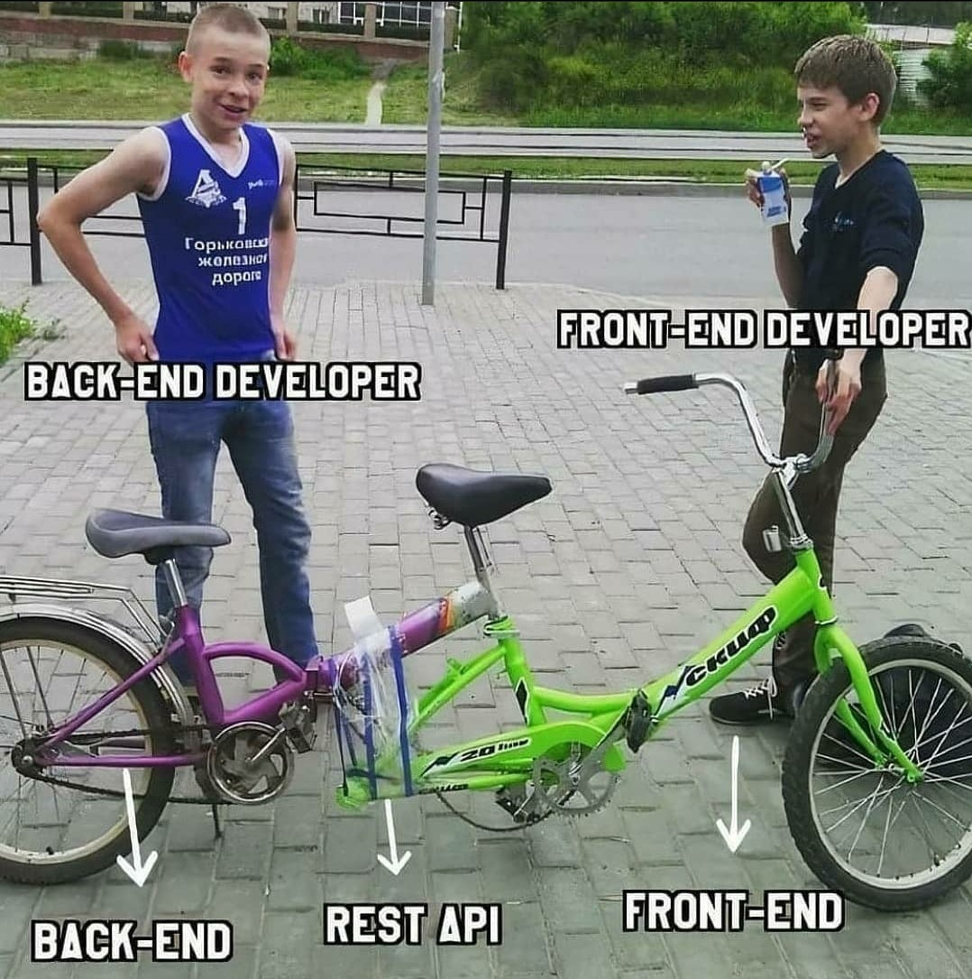
So, why APIs for deployment?
Assume you have trained a predictive model for real estate price estimation.
You have packaged your model and is ready for deployment
Another team is responsible for developing a web application where users estimate the price of their property!
You need to create a robust API for your model so the second team can integrate it into their application!!
Notes:
This is what an API is for our mL world.
(Read the example)

Slide 56
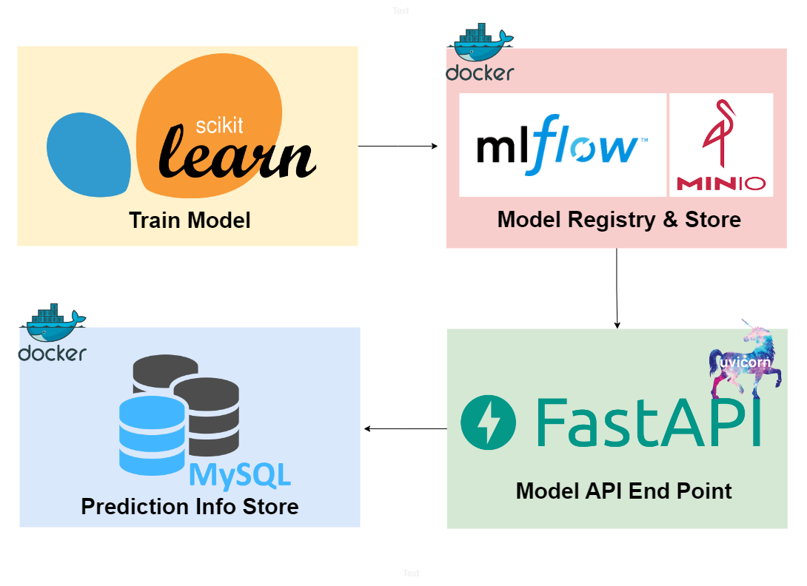
Enter FastAPI
Definition
FastAPI is a user-friendly framework for creating APIs with python.
Its designed to be fast, easy to use and production-ready.
In simple terms it accelerates the backend development of a website using Python.
Clear documentation for FastAPI: here
Notes:
And now that we have an idea for the significance of APIs lets see how we can make them!
We are going to use FastAPI. As of this week its the second most used framework after Django
I find it more easy to work with FastAPI and thats why I preferred it.
Its very simple, fast and relatively straightforward to deploy applications using FastAPI
On the right you can see the general flow of an application using FastAPI.
You train a model,
You store it somewhere
You create the API using FastAPI
You dockerize it
Users can then make predictions

Slide 57
Why FastAPI?
Flask is the most well framework for APIs, but:
Features | FastAPI | Flask
Ease of Learning | Intuitive with automatic interactive documentation | Simple and beginner Friendly
Performance | Faster execution due to type checking | Good but slower than FastAPI
Data Validation | Automatic validation | Manual setup required
API Documentation | Automatic generation | Manual setup
We will be working with FastAPI because of its speed and easy of use.
It aligns with our focus on building fast user-friendly APIs for AI applications.
Notes:
Ok a disclaimer.
Flask is the msot well know framework for APIs.
However there are some limitations and I have a reason for picking FastAPI.
The main reasons are speed and how user frielindly it is.
It aligns very well with AI applications and you can easility combine it with streamlit and Docker
So for this c ourse we are going to use FastAPI

Slide 58

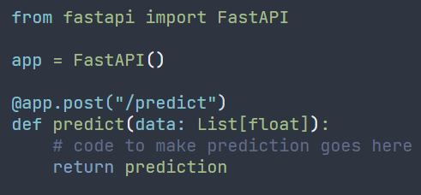
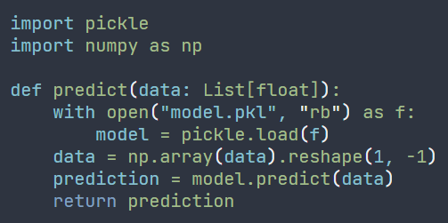
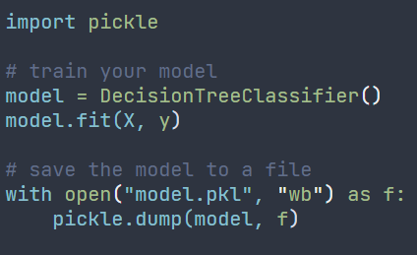
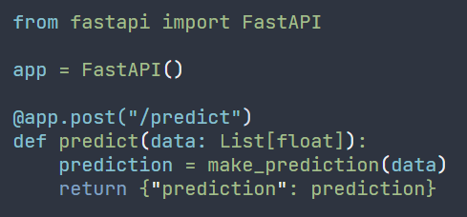
How to deploy a Scikit-Learn Model using FastAPI
Step 1: Install libraries
Step 3: Create a FastAPI application
and define an endpoint to your API
Step 4: Define a function that loads the model and makes predictions
Step 2: Train and save the model to a file
(pickle is the go-to here)
Step 5: Return the predictions in the API response
Step 6: Send a POST request to your API
Notes:
Allright. This is the general flow for deploying models using FastAPI.
(Just review the steps here one by one!)
Pretty straightforward.
We are going to see some examples later so you understand it better!

Slide 59
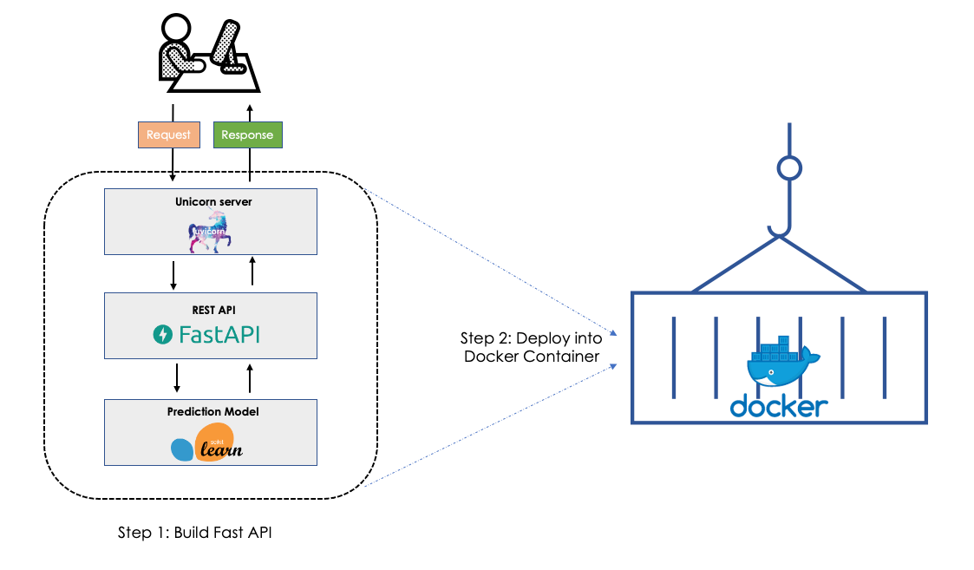
FastAPI and Docker
FastAPI is used for communicating with your model/database etc
Docker ensures the application runs the same way everywhere by packaging it with all its dependencies
By combining the two, you get a consistent environment offering easy deployment and scalability
Notes:
Ok, now lets see how we can combine our two frameworks and make them work together.
As we said
FastAPI is used to make the communication between our pretrained models, our database etc
Then we have Docker which will ensure that our application (that uses FastAPI to talk to a model) will work the same across all environments
If you use these two you can get consistent predictions, reproducible results
Its very easy to deploy and easy to scale!
We are going to see some examples later!

Slide 60
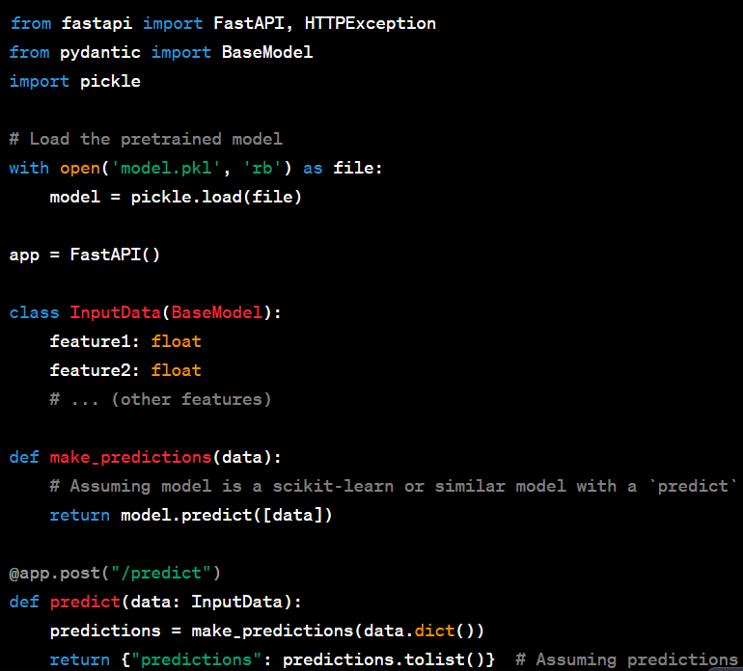
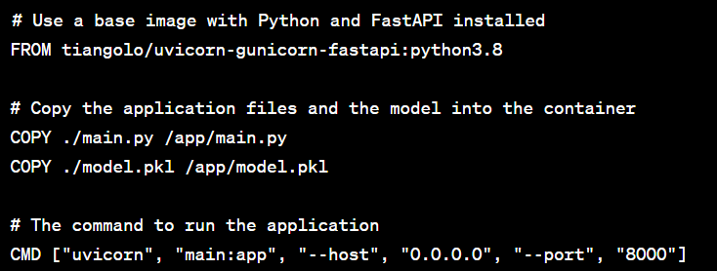
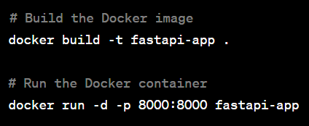
Combine Docker with FastAPI
Assume you have already developed an API for your pretrained model
You dockerize it by building the DockerFile
Careful: You also copy the model from pickle into the container!!!
You build the Docker image and the container
Notes:
Allright this is an example of how we use Docker and FastAPI
We have a pretrained model which we load
We define the FastAPI app.
Pay attention that we have also imported BaseModel from pydantic. Its a very important step to making robust API calls with FastAPI!
We define a class that inherits from the base model and we simply define every feature we need for predictions. for every feature we also define its type
We do that to ensure that nothing will fail and that the API call will always use the same data types
We then define a function that makes predictions
And finally we have the predict() function that has decorated the app from fastAPI and takes as input the Class we have defined before
What the function does is to take the other predictions function and use it to return predictions
After we finished with FastAPI we dockerize!
the only difference with what we had before is that also need to copy the saved model
Attention here, you can copy the whole folder that has main.py and model.pkl or do it individually
finally you just build the image and run a container!

Slide 61
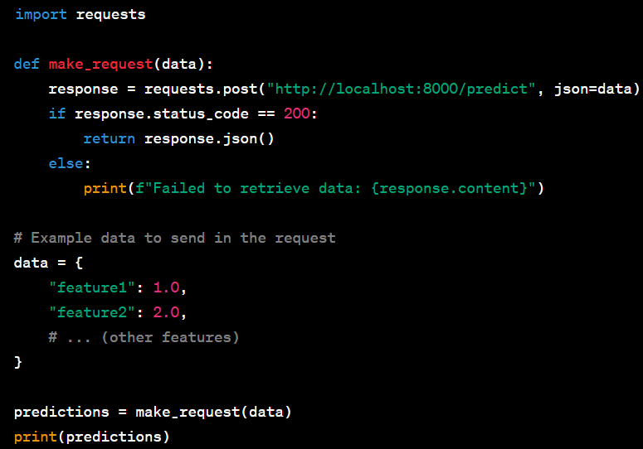
Combine Docker with FastAPI
Once the FastAPI application is running in a Docker container, you can create a simple Python script to make a request to the API.
Create a file named request.py:
or just use the terminal
curl -X POST "http://localhost:8000/predict" -H "accept: application/json" -H "Content-Type: application/json" -d '{"feature1":1.0,"feature2":2.0}'
In this curl command:
-X POST specifies that this is a POST request.
The URL http://localhost:8000/predict is where the request is being sent.
-H "accept: application/json" and -H "Content-Type: application/json" are headers specifying that the request and response should be in JSON format.
-d '{"feature1":1.0,"feature2":2.0}' is the data being sent in the request body, formatted as a JSON object.
Notes:
And once we build our dockerzied application this is how we make predictions.
There are two ways.
Well there are three but I am showing you the two here
The first, the one that is missing is through an interface, a dashboard. We will see examples later!
The second is from our scripts. This is used to integrate a loaded model into a bigger application. Like the examples we had with chatgpt and the other models from hugging face
And finally we have the terminal. I explain what each command means so you can use it or run something equivalent
We have some examples on the second hour we are going to see how it goes!

